Slide 1
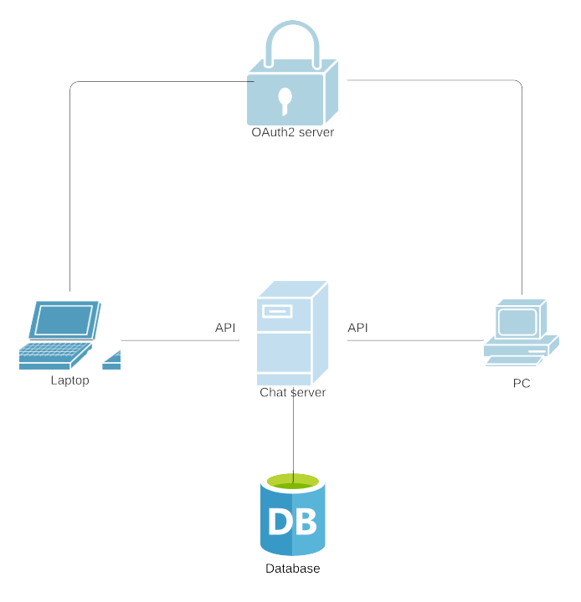
Chat Application with OAuth
Concept
Current Status and Next Steps
Expected Outcome
Planning done
Starting with implementation
Github repo set up
Chat application with secure authorization/authentication

